Slide 1
Mathematical Expectation
Chapter 4

Slide 2
Chapter 4
Chapter 4 goes into more detail on random variables. Using ideas from chapters 2 and 3, we discuss how to find means and variances for random variables.
4.1 covers means, 4.2 covers variances, and 4.3 goes over how to work with linear combinations of random variables.

Slide 3
4.1 – Mean of a Random Variable
To get started, suppose we flip a coin two times. How many times do you expect the coin to land on heads in the two flips?
What if we flipped it four times? Or three? How many times do you expect the coin to land on heads?
Why?

Slide 4
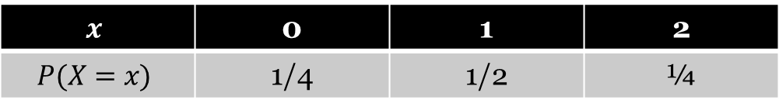
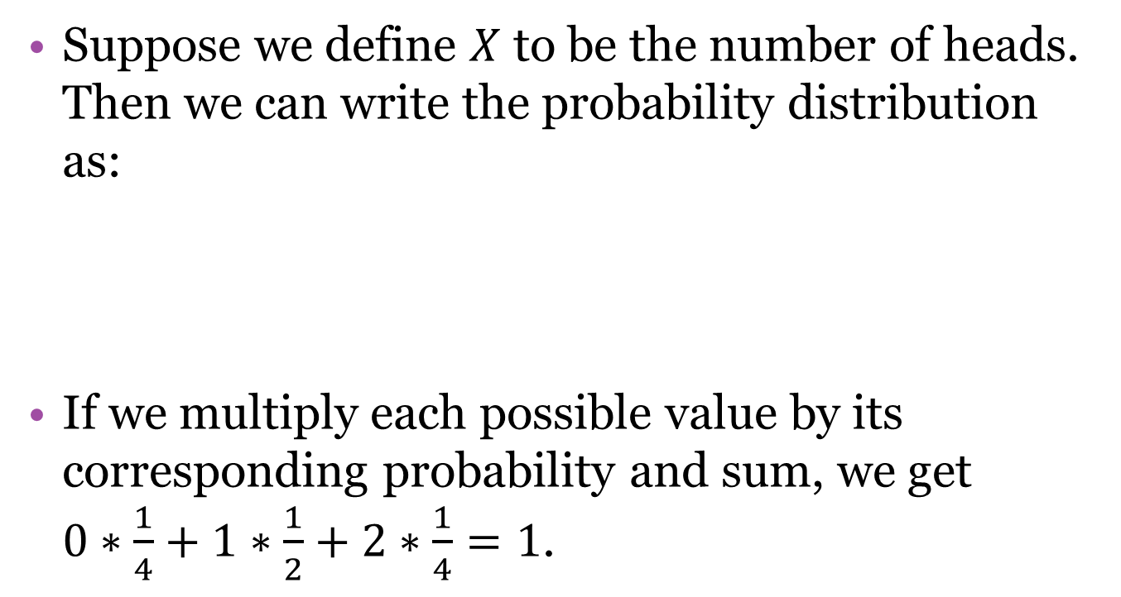
4.1 – Mean of a Random Variable
Suppose we define $X$ to be the number of heads. Then we can write the probability distribution as:
If we multiply each possible value by its corresponding probability and sum, we get $0∗\frac{1}{4}+1∗\frac{1}{2}+2∗\frac{1}{4}=1$.
$$x$$ | 0 | 1 | 2
$$P(X=x)$$ | 1/4 | 1/2 | ¼

Slide 5
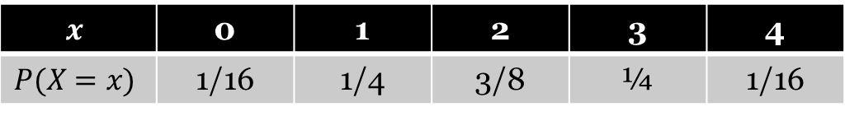
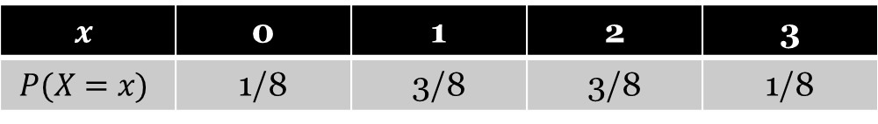
4.1 – Mean of a Random Variable
Doing the same thing with the other two distributions
we find that the expected number of heads is 1.5, and 2, respectively.
$$x$$ | 0 | 1 | 2 | 3
$$P(X=x)$$ | 1/8 | 3/8 | 3/8 | 1/8
$$x$$ | 0 | 1 | 2 | 3 | 4
$$P(X=x)$$ | 1/16 | 1/4 | 3/8 | ¼ | 1/16

Slide 6
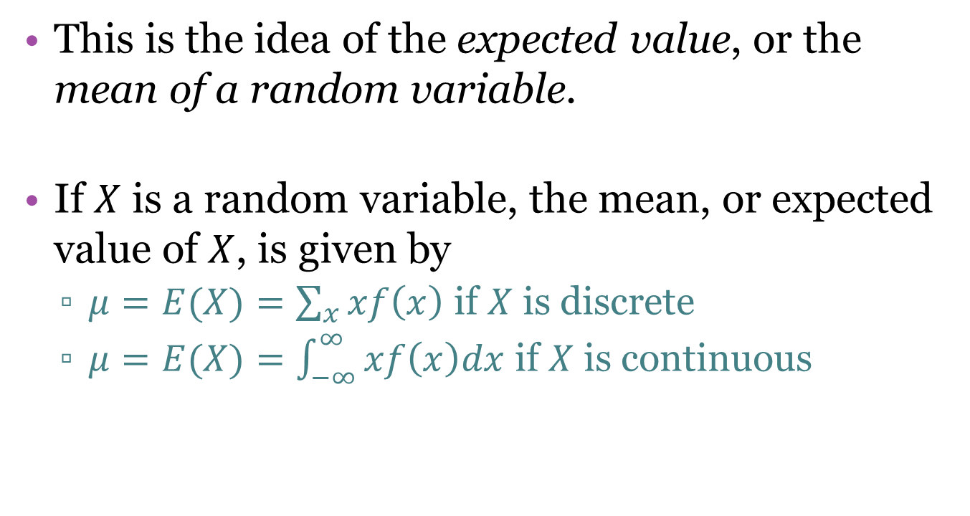
4.1 – Mean of a Random Variable
This is the idea of the expected value, or the mean of a random variable.
If $X$ is a random variable, the mean, or expected value of $X$, is given by
  $μ=E(X)=\sum_{x}^{ }{xf\left(x\right)}$ if $X$ is discrete
  $μ=E(X)=\int_{−∞}^{∞}{xf\left(x\right)dx}$ if $X$ is continuous

Slide 7
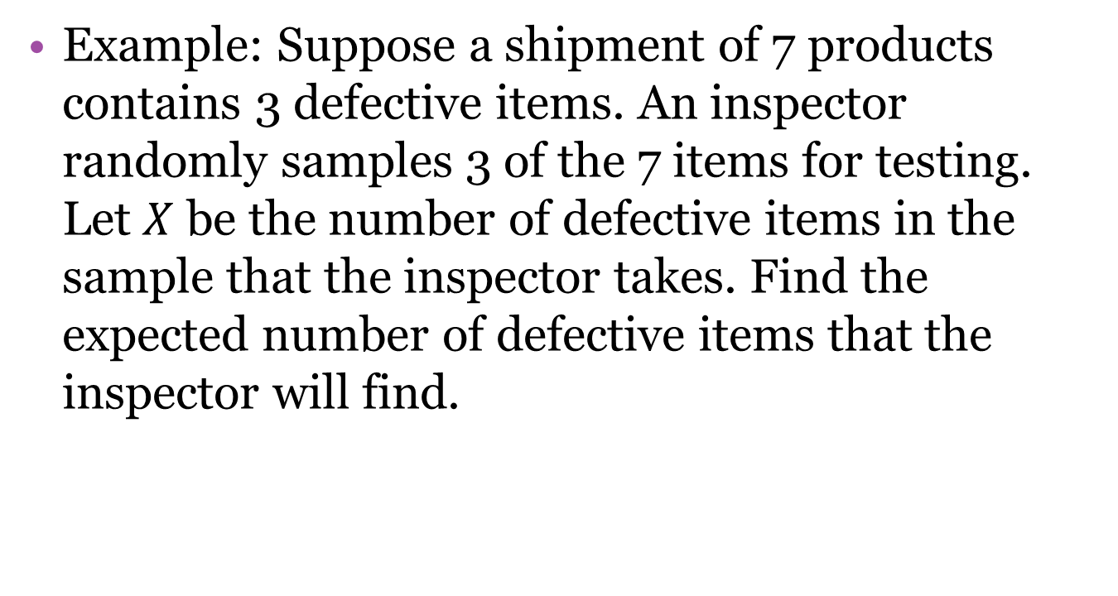
4.1 – Mean of a Random Variable
Example: Suppose a shipment of 7 products contains 3 defective items. An inspector randomly samples 3 of the 7 items for testing. Let $X$ be the number of defective items in the sample that the inspector takes. Find the expected number of defective items that the inspector will find.

Slide 8
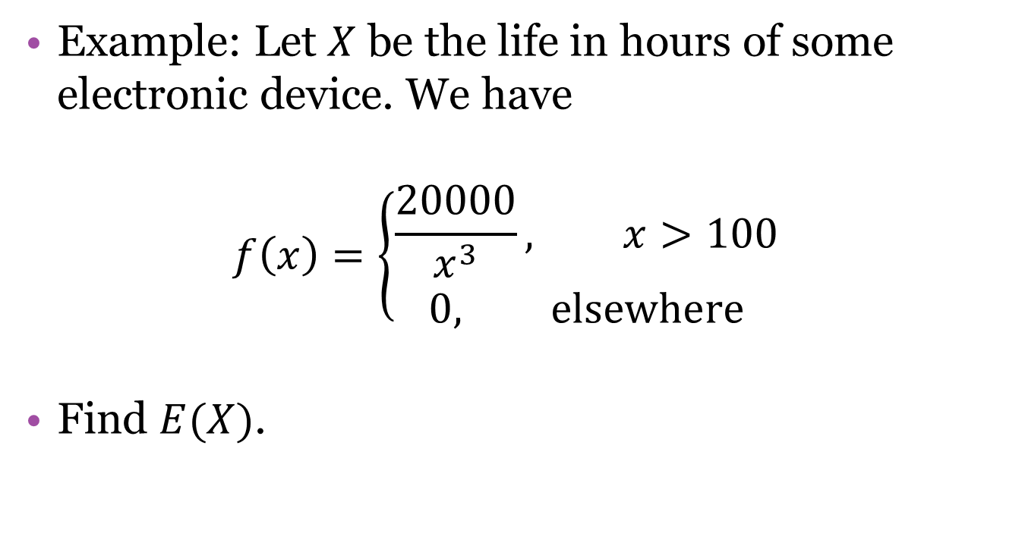
4.1 – Mean of a Random Variable
Example: Let $X$ be the life in hours of some electronic device. We have
$$f\left(x\right)=\left\{\begin{aligned}\frac{20000}{x^{3}}, x>100 \\ 0, elsewhere\end{aligned}\right.$$
Find $E(X)$.

Slide 9
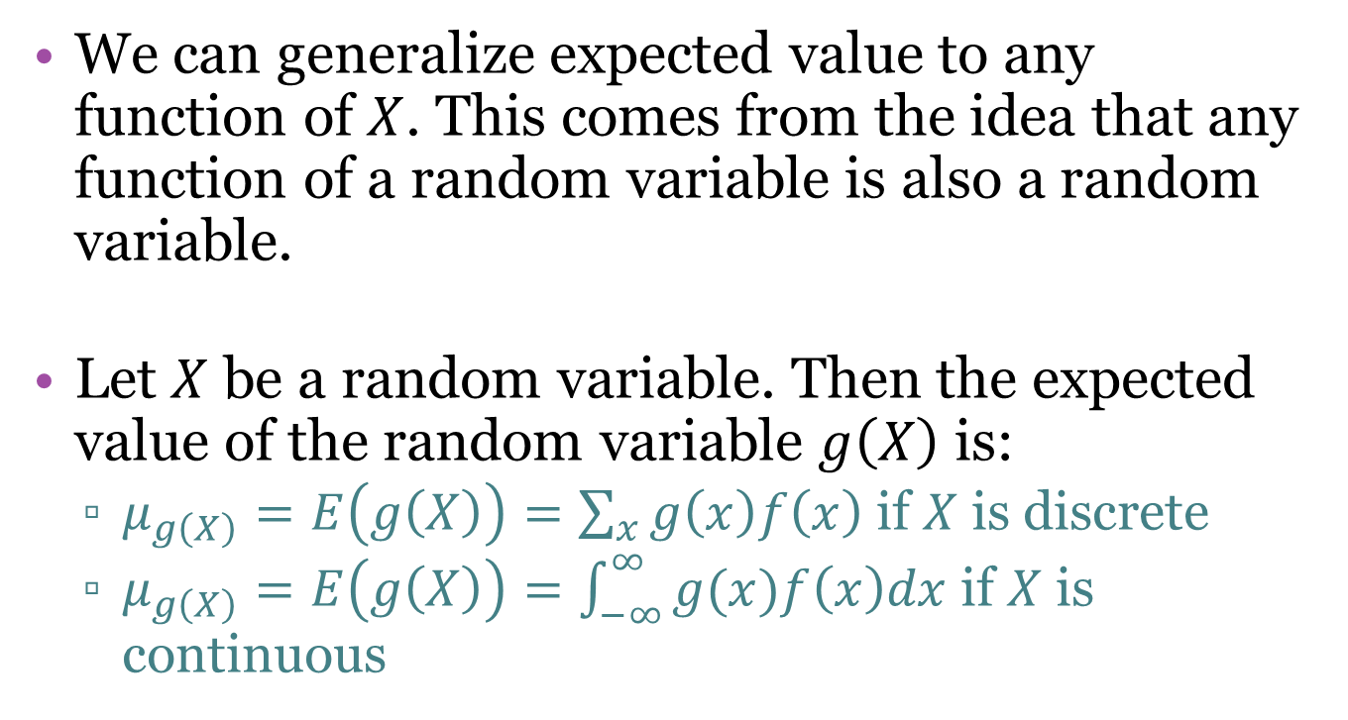
4.1 – Mean of a Random Variable
We can generalize expected value to any function of $X$. This comes from the idea that any function of a random variable is also a random variable.
Let $X$ be a random variable. Then the expected value of the random variable $g\left(X\right)$ is:
  $μ_{g\left(X\right)}=E\left(g\left(X\right)\right)=\sum_{x}^{ }{g\left(x\right)f\left(x\right)}$ if $X$ is discrete
  $μ_{g\left(X\right)}=E\left(g\left(X\right)\right)=\int_{−∞}^{∞}{g(x)f\left(x\right)dx}$ if $X$ is continuous

Slide 10
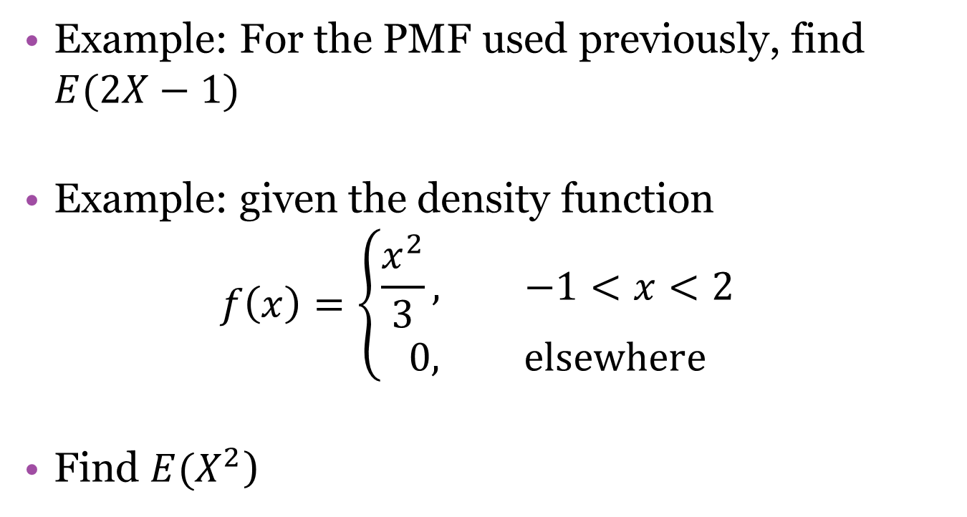
4.1 – Mean of a Random Variable
Example: For the PMF used previously, find $E(2X−1)$
Example: given the density function
$$f\left(x\right)=\left\{\begin{aligned}\frac{x^{2}}{3}, −1<x<2 \\ 0, elsewhere\end{aligned}\right.$$
Find $E(X^{2}$)

Slide 11
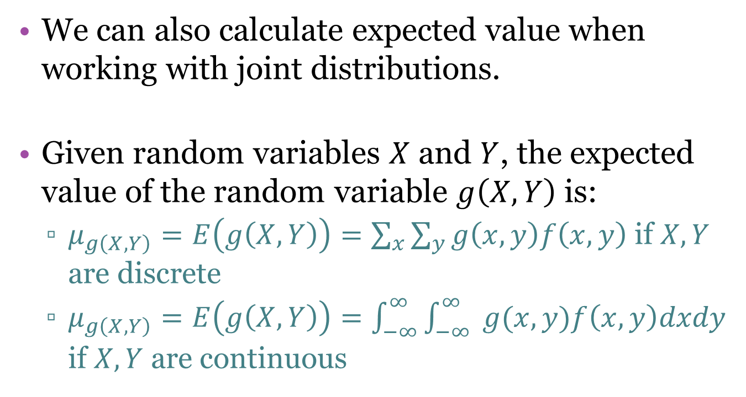
4.1 – Mean of a Random Variable
We can also calculate expected value when working with joint distributions.
Given random variables $X$ and $Y$, the expected value of the random variable $g\left(X,Y\right)$ is:
  $μ_{g\left(X,Y\right)}=E\left(g\left(X,Y\right)\right)=\sum_{x}^{ }{\sum_{y}{g\left(x,y\right)f\left(x,y\right)}}$ if $X, Y$ are discrete
  $μ_{g\left(X,Y\right)}=E\left(g\left(X,Y\right)\right)=\int_{−∞}^{∞}{\int_{−∞}^{∞}{ }g(x,y)f\left(x,y\right)dxdy}$ if $X,Y$ are continuous

Slide 12
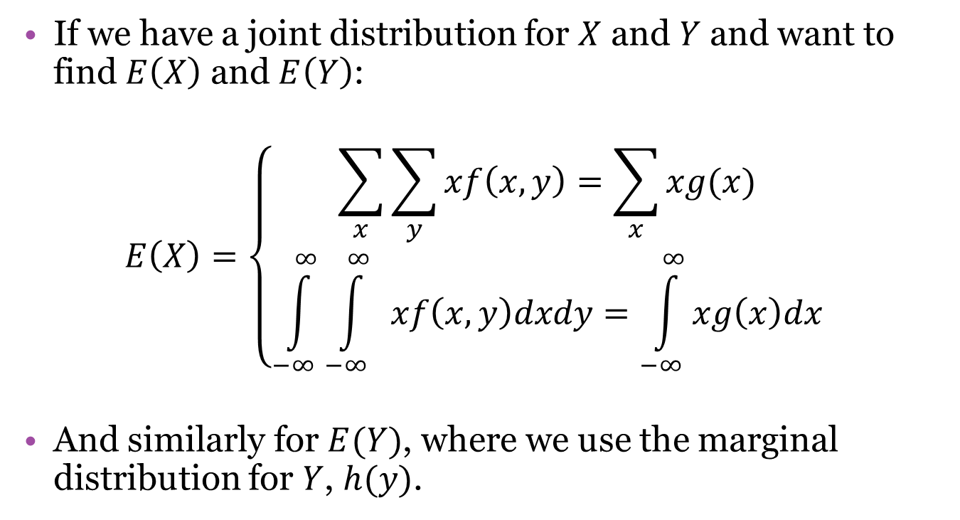
4.1 – Mean of a Random Variable
If we have a joint distribution for $X$ and $Y$ and want to find $E\left(X\right)$ and $E\left(Y\right)$:
$$E\left(X\right)=\left\{\begin{aligned}\sum_{x}^{ }{\sum_{y}{xf\left(x,y\right)}}=\sum_{x}{xg(x)} \\ \int_{−∞}^{∞}{\int_{−∞}^{∞}{ }xf\left(x,y\right)dxdy}=\int_{−∞}^{∞}{xg\left(x\right)dx}\end{aligned}\right.$$
And similarly for $E(Y)$, where we use the marginal distribution for $Y$, $h(y)$.

Slide 13

4.1 – Mean of a Random Variable
Exercise: Given the joint PDF $f\left(x,y\right)=\frac{x\left(1+3y^{2}\right)}{4}$, $0<x<2, 0<y<1$ and $0$ elsewhere, find $E\left(\frac{Y}{X}\right), E\left(Y\right),$ and $E(X)$.

Slide 14
4.1 – Mean of a Random Variable
Exercise: An American roulette wheel has 38 pockets, numbered 1-36 with 0 and 00 as pockets as well. 18 of the pockets are red, 18 are black, and 0 and 00 are green. Suppose you bet $1 on red. This means that if the ball lands in a red pocket, you win. If it lands in black or green, you lose your dollar.

Slide 15
4.1 – Mean of a Random Variable
Exercise continued: There are a number of other possible bets as well. For each of the following $1 bets, find the expected amount of money you will win:
  Bet $1 on red, worth $1 if you win
  Bet $1 that the ball will land in any one of 6 selected pockets, worth $5 if you win
  Bet $1 that the ball will land in a certain pocket, worth $35 if you win

Slide 16
4.2 – Variance and Covariance
4.1 focused on the mean of a random variable. This section looks at variance of a random variable. We also introduce the idea of covariance, which is a way to describe the relationship between two random variables.

Slide 17
4.2 – Variance and Covariance
When we discussed the sample mean, we said that a measure of center is not enough to understand a data set.
The same idea applies to random variables. To understand the distribution of a random variable, we (almost always) need to know more than just where it is centered – we need to know how spread out it is.

Slide 18
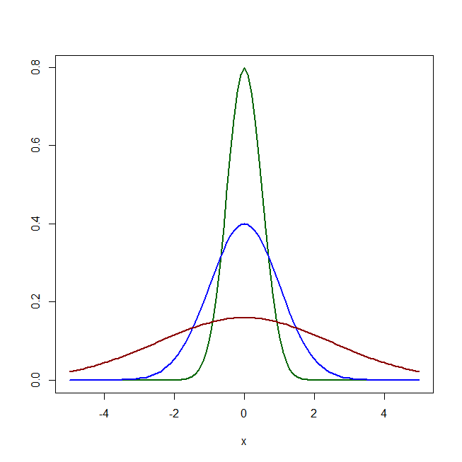
4.2 – Variance and Covariance

Slide 19
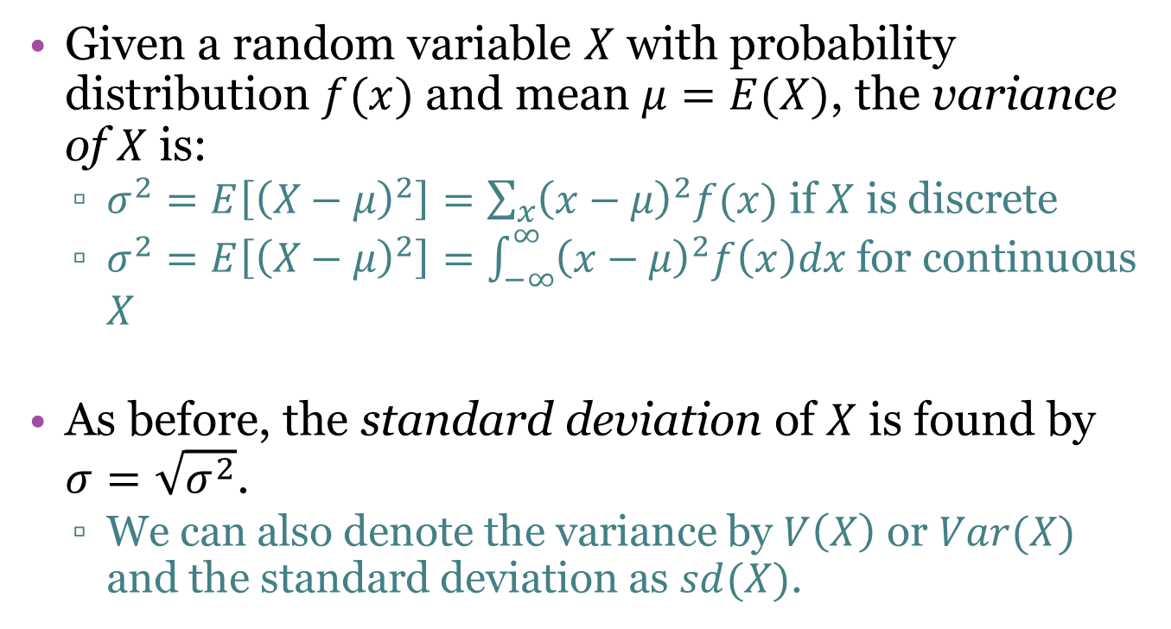
4.2 – Variance and Covariance
Given a random variable $X$ with probability distribution $f(x)$ and mean $μ=E(X)$, the variance of $X$ is:
  $σ^{2}=E\left[{\left(X−μ\right)}^{2}\right]=\sum_{x}{{\left(x−μ\right)}^{2}f(x)}$ if $X$ is discrete
  $σ^{2}=E\left[{\left(X−μ\right)}^{2}\right]=\int_{−∞}^{∞}{{\left(x−μ\right)}^{2}f\left(x\right)dx}$ for continuous $X$
As before, the standard deviation of $X$ is found by $σ=\sqrt{σ^{2}}$.
  We can also denote the variance by $V\left(X\right)$ or $Var(X)$ and the standard deviation as $sd(X)$.

Slide 20
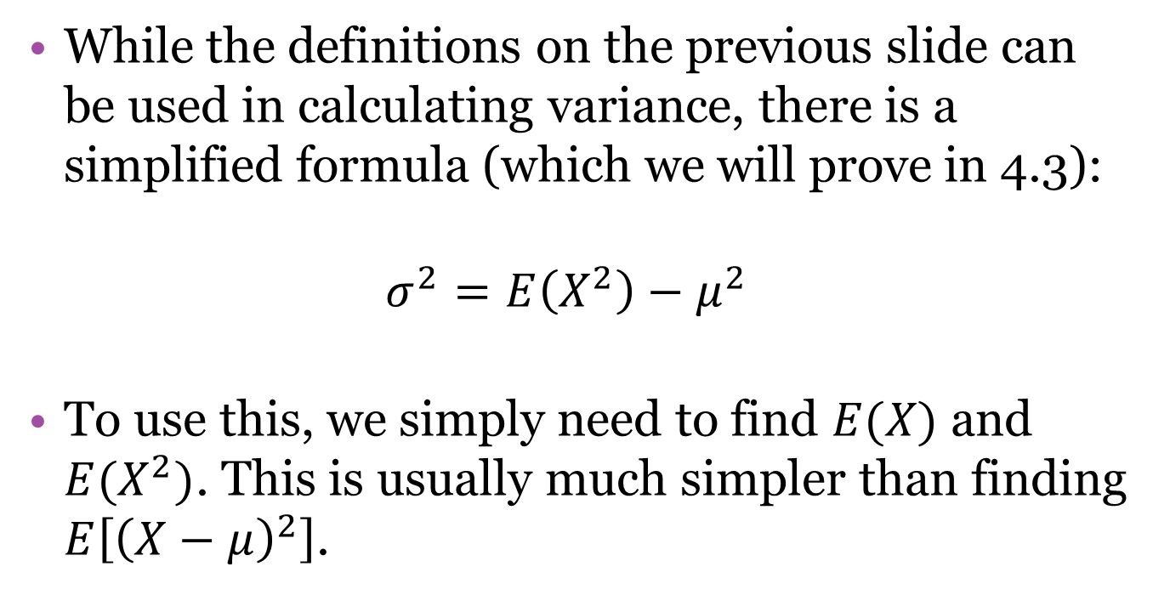
4.2 – Variance and Covariance
While the definitions on the previous slide can be used in calculating variance, there is a simplified formula (which we will prove in 4.3):
$$σ^{2}=E\left(X^{2}\right)−μ^{2}$$
To use this, we simply need to find $E(X)$ and $E(X^{2})$. This is usually much simpler than finding $E\left[{\left(X−μ\right)}^{2}\right]$.

Slide 21
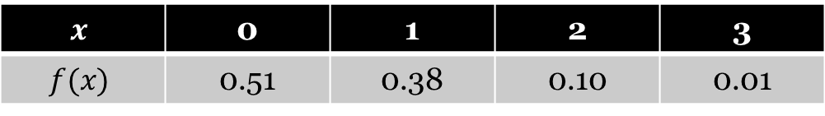
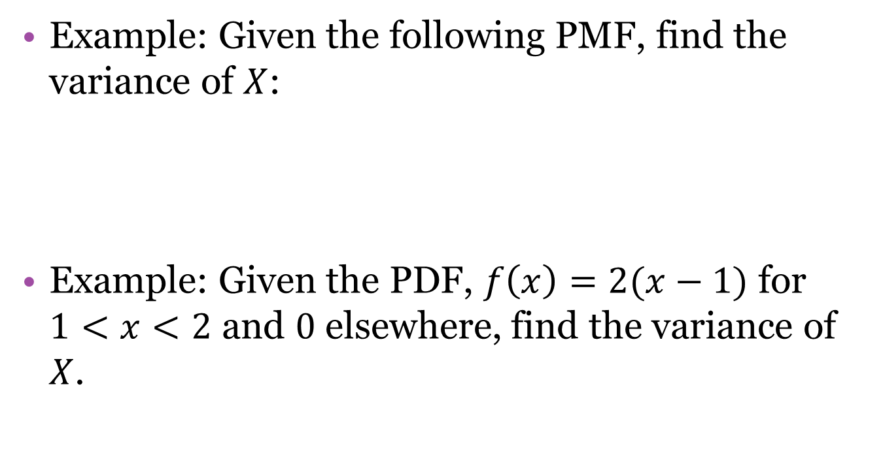
4.2 – Variance and Covariance
Example: Given the following PMF, find the variance of $X$:
Example: Given the PDF, $f\left(x\right)=2(x−1)$ for $1<x<2$ and $0$ elsewhere, find the variance of $X$.
$$x$$ | 0 | 1 | 2 | 3
$$f(x)$$ | 0.51 | 0.38 | 0.10 | 0.01

Slide 22
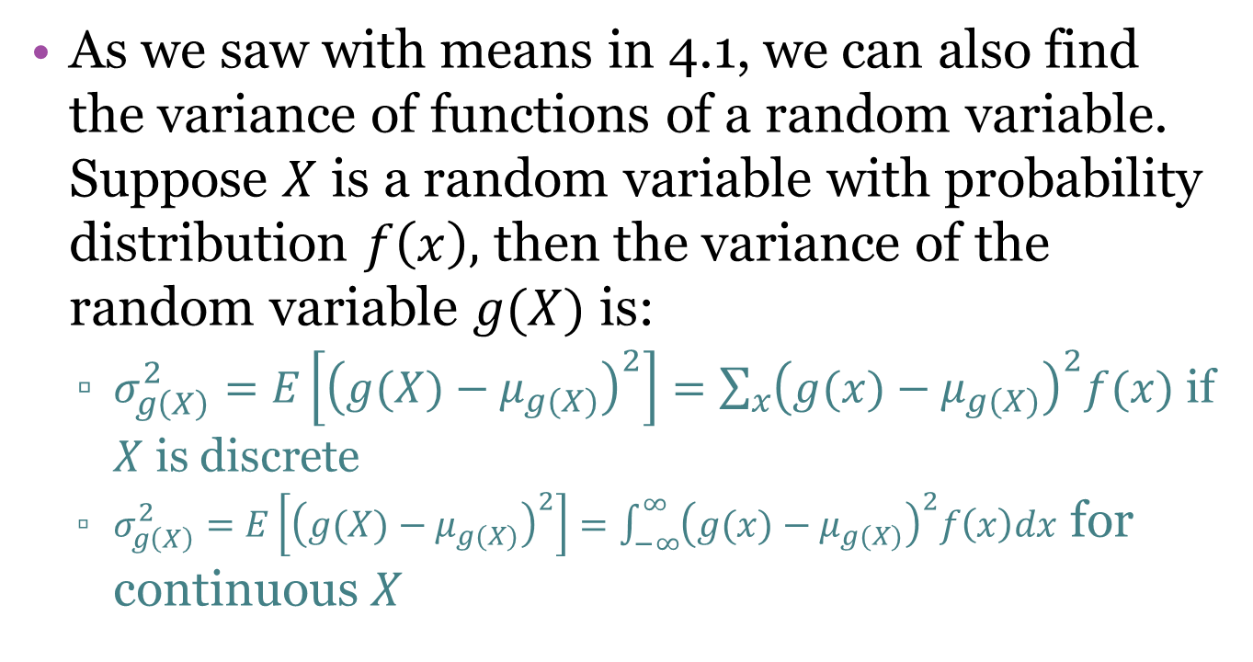
4.2 – Variance and Covariance
As we saw with means in 4.1, we can also find the variance of functions of a random variable. Suppose $X$ is a random variable with probability distribution $f\left(x\right),$ then the variance of the random variable $g(X)$ is:
  $σ_{g\left(X\right)}^{2}=E\left[{\left(g(X)−μ_{g(X)}\right)}^{2}\right]=\sum_{x}{{\left(g(x)−μ_{g(X)}\right)}^{2}f(x)}$ if $X$ is discrete
  $σ_{g\left(X\right)}^{2}=E\left[{\left(g(X)−μ_{g(X)}\right)}^{2}\right]=\int_{−∞}^{∞}{{\left(g(x)−μ_{g(X)}\right)}^{2}f\left(x\right)dx}$ for continuous $X$

Slide 23
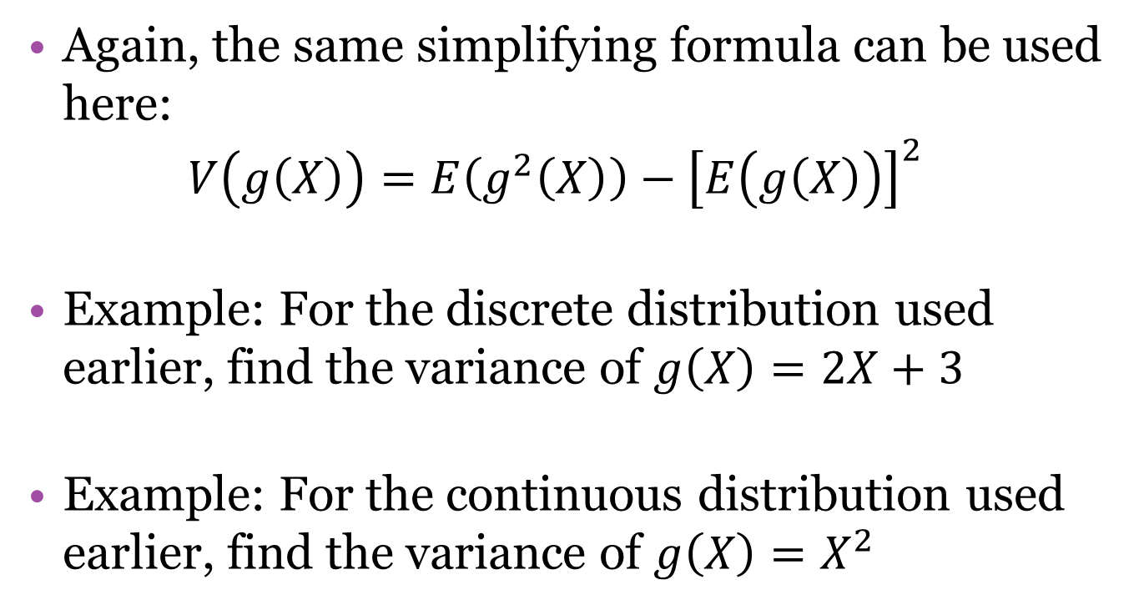
4.2 – Variance and Covariance
Again, the same simplifying formula can be used here:
$$V\left(g\left(X\right)\right)=E\left(g^{2}\left(X\right)\right)−{\left[E\left(g\left(X\right)\right)\right]}^{2}$$
Example: For the discrete distribution used earlier, find the variance of $g\left(X\right)=2X+3$
Example: For the continuous distribution used earlier, find the variance of $g\left(X\right)=X^{2}$

Slide 24
4.2 – Variance and Covariance
When we have two random variables, we can obtain a measure of how they vary together, or “co-vary.”
The measure we use is called the covariance. The main thing it tells us is whether the random variables have a positive or negative relationship.

Slide 25
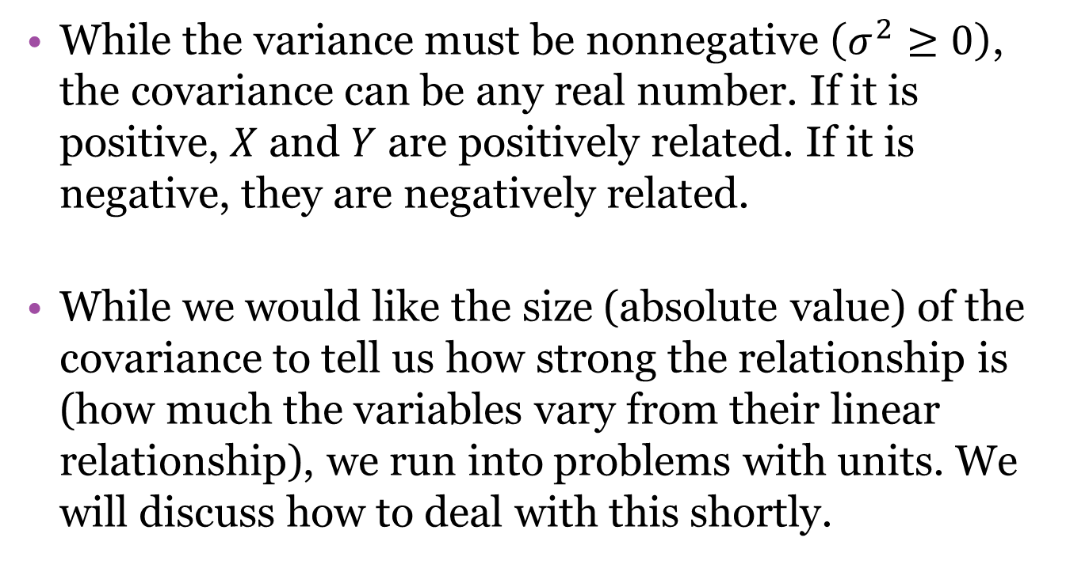
4.2 – Variance and Covariance
While the variance must be nonnegative $\left(σ^{2}≥0\right)$, the covariance can be any real number. If it is positive, $X$ and $Y$ are positively related. If it is negative, they are negatively related.
While we would like the size (absolute value) of the covariance to tell us how strong the relationship is (how much the variables vary from their linear relationship), we run into problems with units. We will discuss how to deal with this shortly.

Slide 26
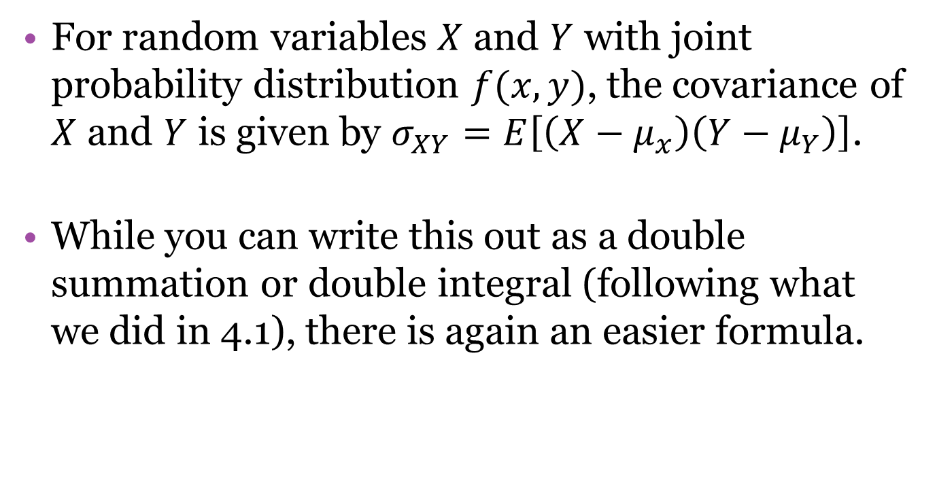
4.2 – Variance and Covariance
For random variables $X$ and $Y$ with joint probability distribution $f(x,y)$, the covariance of $X$ and $Y$ is given by $σ_{XY}=E\left[\left(X−μ_{x}\right)\left(Y−μ_{Y}\right)\right]$.
While you can write this out as a double summation or double integral (following what we did in 4.1), there is again an easier formula.

Slide 27
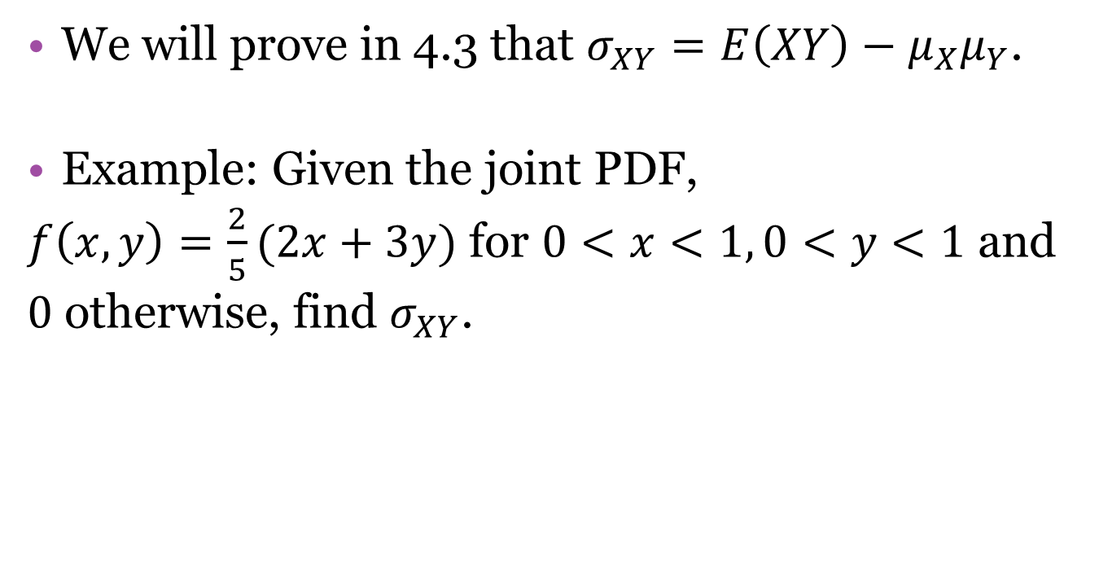
4.2 – Variance and Covariance
We will prove in 4.3 that $σ_{XY}=E\left(XY\right)−μ_{X}μ_{Y}$.
Example: Given the joint PDF,
$f\left(x,y\right)=\frac{2}{5}(2x+3y)$ for $0<x<1, 0<y<1$ and $0$ otherwise, find $σ_{XY}$.

Slide 28
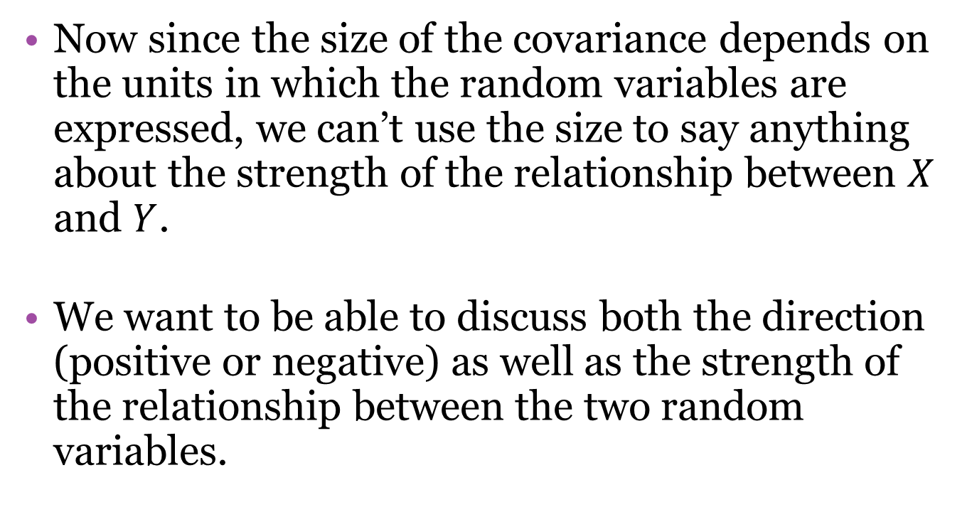
4.2 – Variance and Covariance
Now since the size of the covariance depends on the units in which the random variables are expressed, we can’t use the size to say anything about the strength of the relationship between $X$ and $Y$.
We want to be able to discuss both the direction (positive or negative) as well as the strength of the relationship between the two random variables.

Slide 29
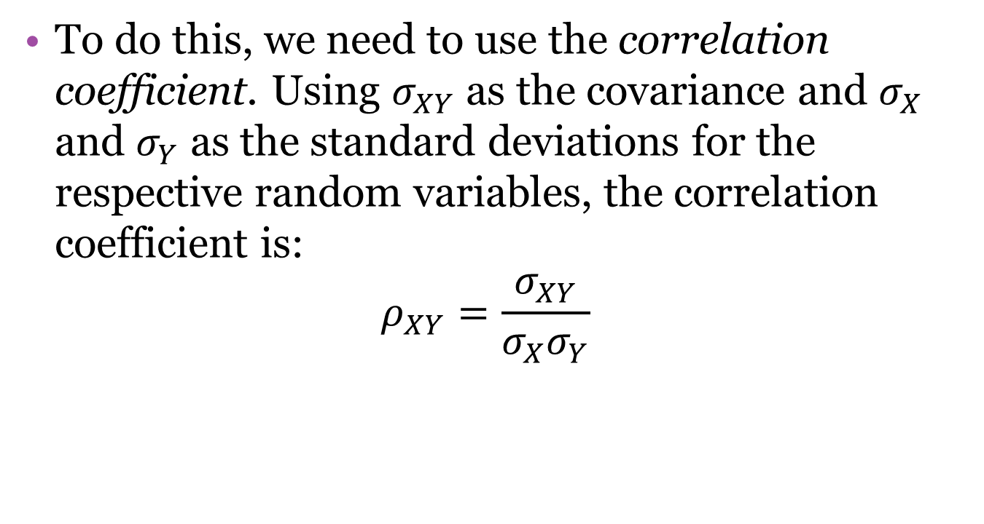
4.2 – Variance and Covariance
To do this, we need to use the correlation coefficient. Using $σ_{XY}$ as the covariance and $σ_{X}$ and $σ_{Y}$ as the standard deviations for the respective random variables, the correlation coefficient is:
$$ρ_{XY}=\frac{σ_{XY}}{σ_{X}σ_{Y}}$$

Slide 30
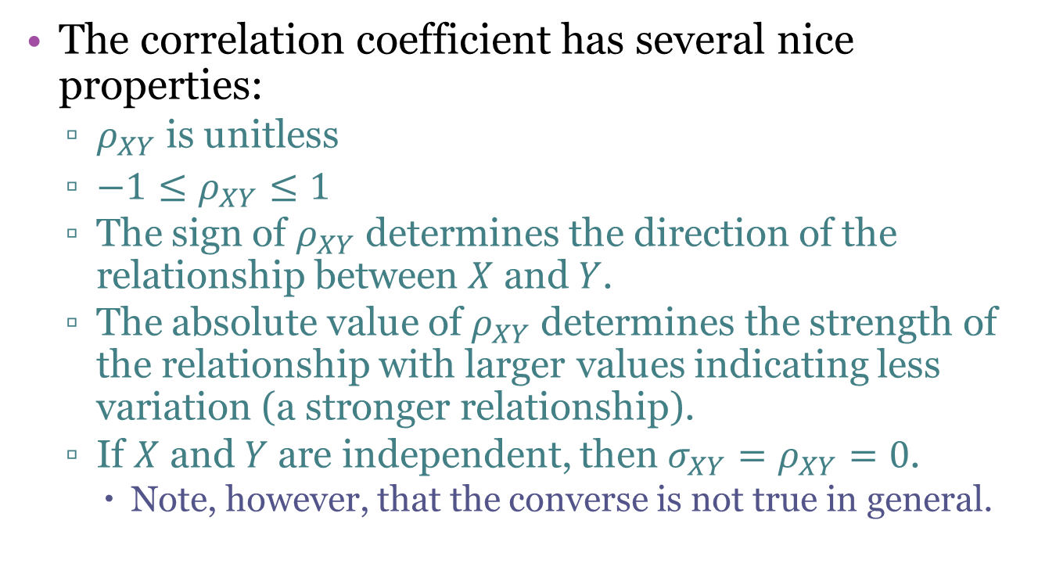
4.2 – Variance and Covariance
The correlation coefficient has several nice properties:
  $ρ_{XY}$ is unitless
  $−1≤ρ_{XY}≤1$
  The sign of $ρ_{XY}$ determines the direction of the relationship between $X$ and $Y$.
  The absolute value of $ρ_{XY}$ determines the strength of the relationship with larger values indicating less variation (a stronger relationship).
  If $X$ and $Y$ are independent, then $σ_{XY}=ρ_{XY}=0$.
    Note, however, that the converse is not true in general.

Slide 31
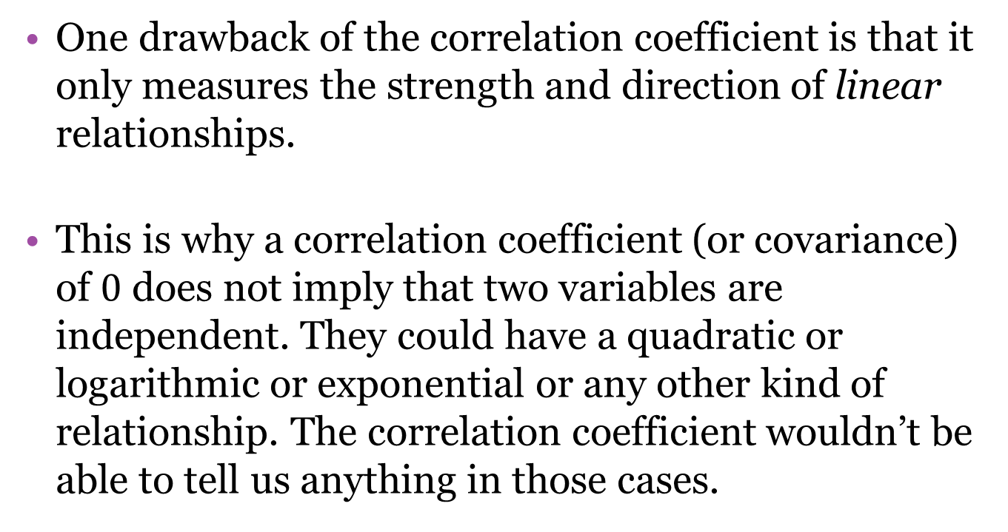
4.2 – Variance and Covariance
One drawback of the correlation coefficient is that it only measures the strength and direction of linear relationships.
This is why a correlation coefficient (or covariance) of $0$ does not imply that two variables are independent. They could have a quadratic or logarithmic or exponential or any other kind of relationship. The correlation coefficient wouldn’t be able to tell us anything in those cases.

Slide 32

4.2 – Variance and Covariance
Exercise: For the joint PDF, $f\left(x,y\right)=\frac{2}{5}(2x+3y)$ for $0<x<1, 0<y<1$ and $0$ otherwise, find $ρ_{XY}$ and comment on the direction and strength of the linear relationship between $X$ and $Y$.

Slide 33
4.2 – Variance and Covariance
Exercise: For each of the following $1 bets, find the standard deviation of the money you will win:
  Bet $1 on red, worth $1 if you win
  Bet $1 that the ball will land in any one of 6 selected pockets, worth $5 if you win
  Bet $1 that the ball will land in a certain pocket, worth $35 if you win

Slide 34
4.3 – Linear Combinations of Random Variables
In this section we will learn properties of expected value that will help us in calculating means and variances for linear combinations of random variables.
While we will not spend time proving these, it is helpful to note that in the continuous case, these are all simply properties of integrals.

Slide 35
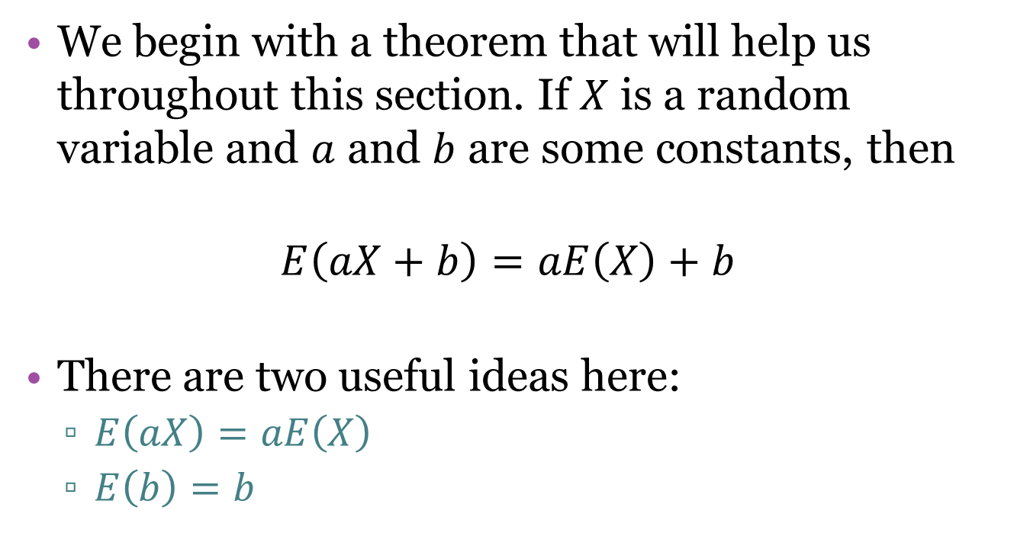
4.3 – Linear Combinations of Random Variables
We begin with a theorem that will help us throughout this section. If $X$ is a random variable and $a$ and $b$ are some constants, then
$$E\left(aX+b\right)=aE\left(X\right)+b$$
There are two useful ideas here:
  $E\left(aX\right)=aE\left(X\right)$
  $E\left(b\right)=b$

Slide 36
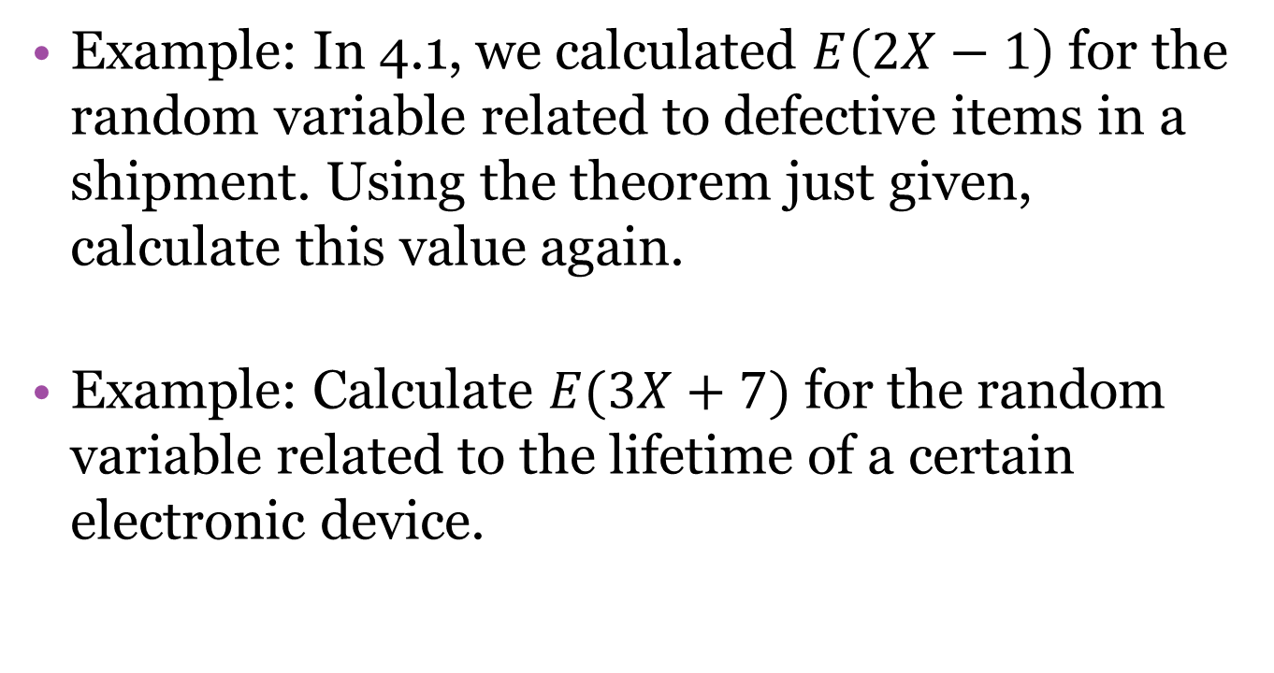
4.3 – Linear Combinations of Random Variables
Example: In 4.1, we calculated $E\left(2X−1\right)$ for the random variable related to defective items in a shipment. Using the theorem just given, calculate this value again.
Example: Calculate $E(3X+7)$ for the random variable related to the lifetime of a certain electronic device.

Slide 37
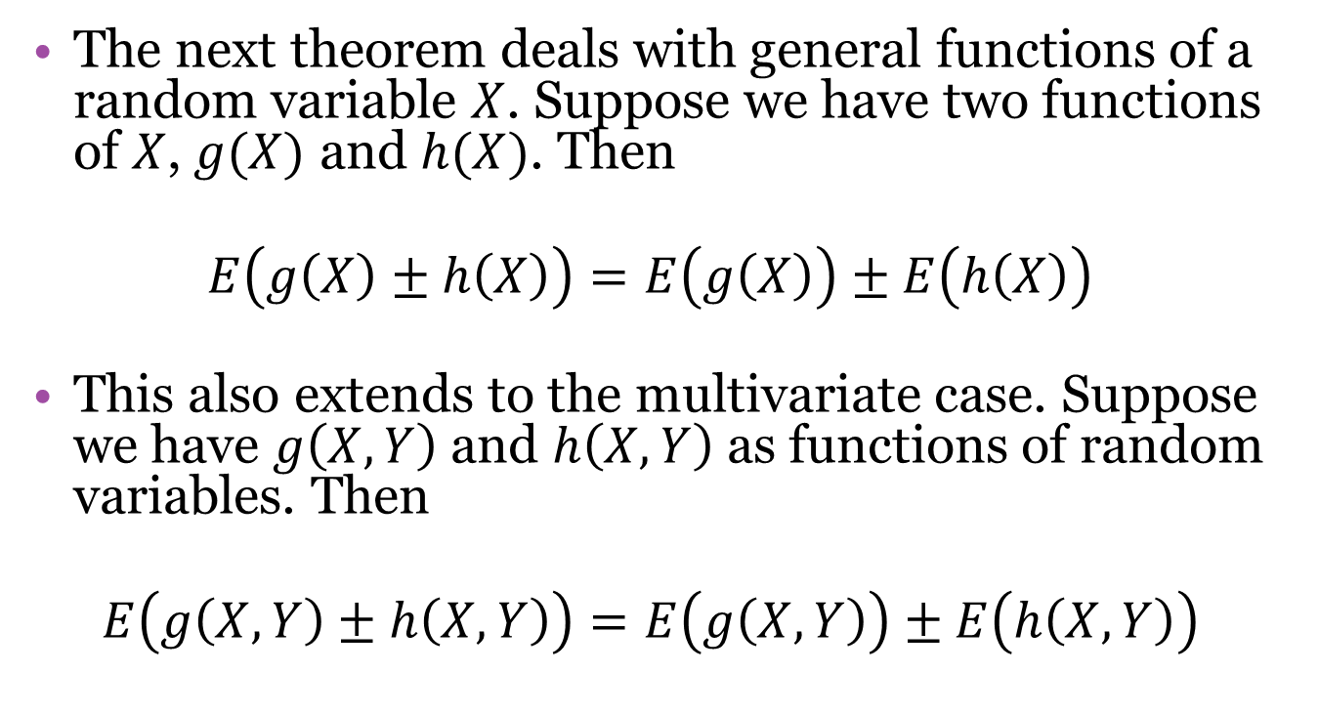
4.3 – Linear Combinations of Random Variables
The next theorem deals with general functions of a random variable $X$. Suppose we have two functions of $X$, $g(X)$ and $h(X)$. Then
$$E\left(g\left(X\right)±h\left(X\right)\right)=E\left(g\left(X\right)\right)±E\left(h\left(X\right)\right)$$
This also extends to the multivariate case. Suppose we have $g\left(X,Y\right)$ and $h\left(X,Y\right)$ as functions of random variables. Then
$$E\left(g\left(X,Y\right)±h\left(X,Y\right)\right)=E\left(g\left(X,Y\right)\right)±E\left(h\left(X,Y\right)\right)$$

Slide 38
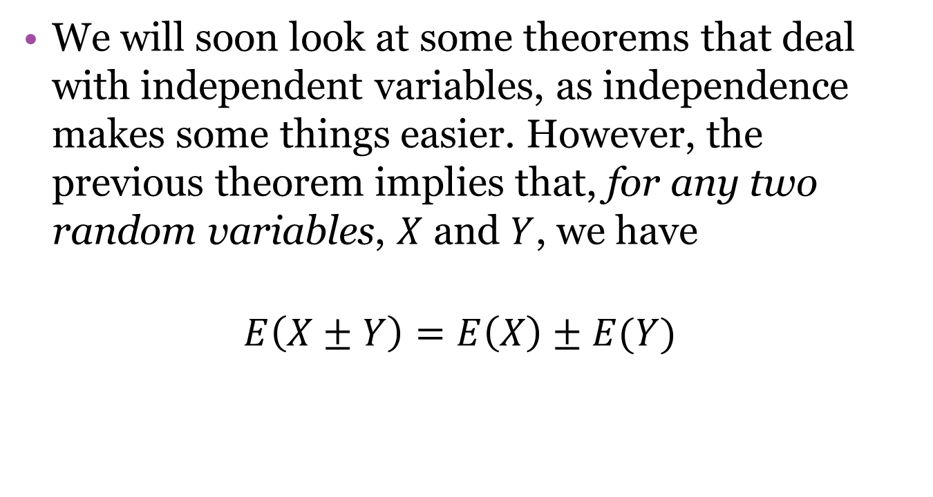
4.3 – Linear Combinations of Random Variables
We will soon look at some theorems that deal with independent variables, as independence makes some things easier. However, the previous theorem implies that, for any two random variables, $X$ and $Y$, we have
$$E\left(X±Y\right)=E\left(X\right)±E(Y)$$

Slide 39

4.3 – Linear Combinations of Random Variables
Example: Given the joint PDF, $f\left(x,y\right)=\frac{x\left(1+3y^{2}\right)}{4}$, $0<x<2, 0<y<1$ and $0$ elsewhere, find $E(3X+2Y−1)$.

Slide 40

4.3 – Linear Combinations of Random Variables
Exercise: In section 4.2, we claimed that for any random variable $X$, $V\left(X\right)=E\left[{\left(X−μ\right)}^{2}\right]=E\left(X^{2}\right)−μ^{2}$. Using the properties introduced so far in this section, prove that this holds.

Slide 41
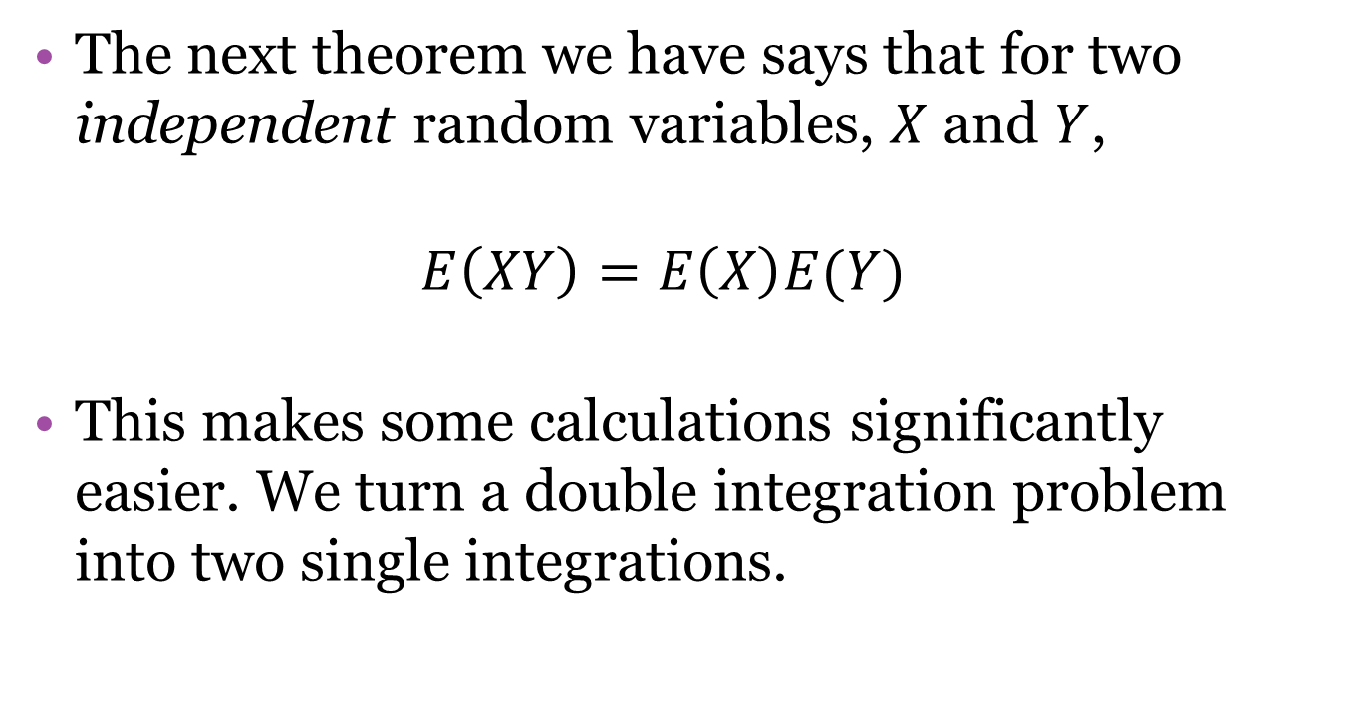
4.3 – Linear Combinations of Random Variables
The next theorem we have says that for two independent random variables, $X$ and $Y$,
$$E\left(XY\right)=E\left(X\right)E(Y)$$
This makes some calculations significantly easier. We turn a double integration problem into two single integrations.

Slide 42
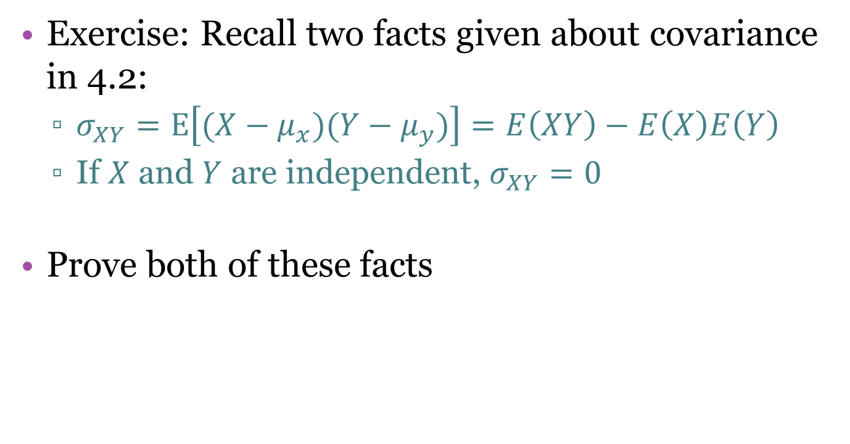
4.3 – Linear Combinations of Random Variables
Exercise: Recall two facts given about covariance in 4.2:
  $σ_{XY}=E\left[(X−μ_{x})(Y−μ_{y})\right]=E\left(XY\right)−E\left(X\right)E\left(Y\right)$
  If $X$ and $Y$ are independent, $σ_{XY}=0$
Prove both of these facts

Slide 43
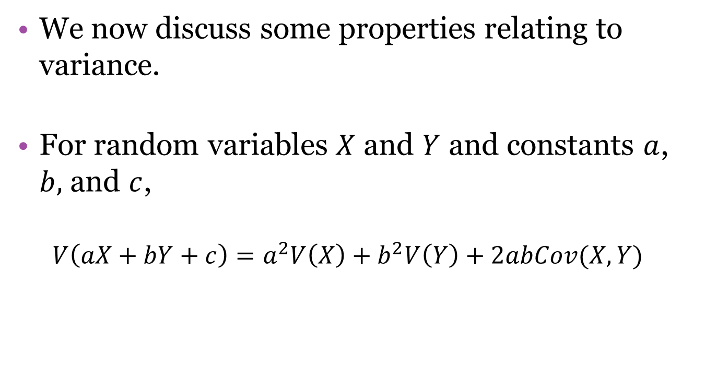
4.3 – Linear Combinations of Random Variables
We now discuss some properties relating to variance.
For random variables $X$ and $Y$ and constants $a$, $b,$ and $c$,
$$V\left(aX+bY+c\right)=a^{2}V\left(X\right)+b^{2}V\left(Y\right)+2abCov(X,Y)$$

Slide 44
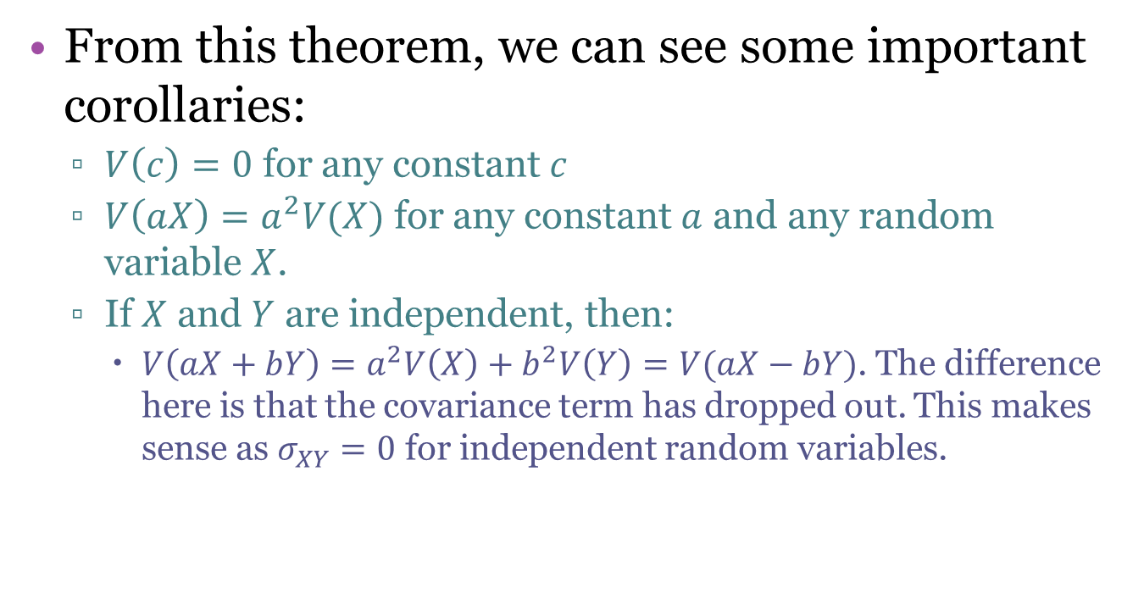
4.3 – Linear Combinations of Random Variables
From this theorem, we can see some important corollaries:
  $V\left(c\right)=0$ for any constant $c$
  $V\left(aX\right)=a^{2}V(X)$ for any constant $a$ and any random variable $X$.
  If $X$ and $Y$ are independent, then:
    $V\left(aX+bY\right)=a^{2}V\left(X\right)+b^{2}V\left(Y\right)=V(aX−bY)$. The difference here is that the covariance term has dropped out. This makes sense as $σ_{XY}=0$ for independent random variables.

Slide 45

4.3 – Linear Combinations of Random Variables
A final corollary relates to $n$ independent random variables. Suppose $X_{1}, X_{2},…, X_{n}$ are independent. Then
$$V\left(a_{1}X_{1}+a_{2}X_{2}+…+a_{n}X_{n}\right)={ a}_{1}^{2}V\left(X_{1}\right)+a_{2}^{2}V\left(X_{2}\right)+…+a_{n}^{2}V\left(X_{n}\right)$$

Slide 46

4.3 – Linear Combinations of Random Variables
Exercise: For the joint PDF $f\left(x,y\right)=\frac{2}{5}(2x+3y)$ for $0<x<1, 0<y<1$ and $0$ otherwise, find $V\left(4X−3Y+10\right)$

